Slide 1
CalWORKs 2.0
Evidence to Practice: Goal Achievement in CalWORKs 2.0
Sacramento, CA
February 21-22, 2019
Michelle Derr, Mathematica
Lindsay Cattell, Mathematica
Notes:
Welcome –
Welcome –

Slide 2
Introductions

Slide 3
Logistics
Lunch orders must be in by 9
Materials on table
Restrooms

Slide 4
CalWORKs 2.0 Overview

Slide 5
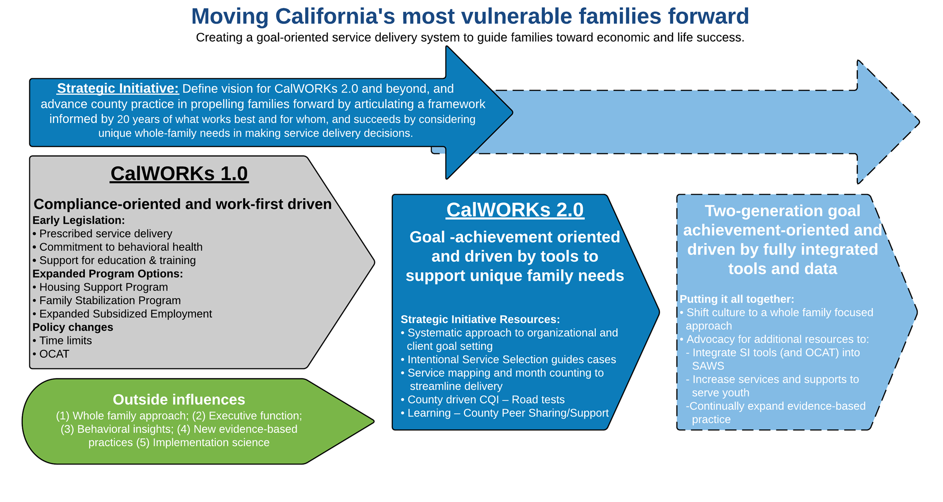
Vision and Hallmarks of CalWORKs 2.0
Goal achievement: Explicitly frame service delivery around setting and achieving meaningful, realistic goals
Intentional service selection: Focus service delivery and goals around family strengths and needs; use common program activities with much greater intentionality

Slide 6
How is this different?
CalWORKs 1.0
Compliance-oriented
Work-first model
CalWORKs 2.0
Driven by customers’ goals
Support unique family needs

Slide 7
Where are we now?
State-wide roll out of principles and tools starting in late 2017/early 2018
Each county is unique
Each county is implementing at their own pace
Some staff have been trained; some are seeing this material for the first time

Slide 8
Purpose of this training
Explore the evidence base that underlies CalWORKs 2.0 and see how it applies to everyday work
Opportunity for deep discussion about how to best integrate this new approach
Introduce to some of the CalWORKs 2.0 tools
Use effective adult learning principles and practices

Slide 9
Objectives
Described ways that the evidence underlying CalWORKs 2.0 affirms and validates what you’ve discovered through practice
Identified ways in which the evidence underlying CalWORKs 2.0 expands your understanding of the strengths and the constraints participants face
Reflected on the intent of selected CalWORKs 2.0 (county and frontline) tools
Named concrete ways in which this evidence base might be useful to you in your role currently

Slide 10
Overview- Day 1
Welcome (8:00 – 8:30)
Session 1 (8:30 - 10:00)
  Adult Capabilities
  Informal conversations
15 min break
Session 2 (10:15 - 11:45)
  Scarcity
  Informal conversations
1 hour lunch
Session 3 (12:45 - 2:45)
  Goal Achievement
  Informal conversations
15 min break
Breakout by staff type (3:00 – 4:00)
Closing (4:00 – 4:30)

Slide 11
Overview- Day 2
Welcome (8:00 - 8:30)
Session 1 (8:30 - 10:30)
  Coaching
15 min break
Session 2 (10:45 - 12:15)
  CW 2.0 tools (part 1)
1 hour lunch
Session 3 (1:15 - 2:45)
  CW 2.0 tools (part 2)
15 min break
Breakout by county (3:00 – 4:00)
Closing (4:00 – 4:30)

Slide 12
Building Adult Capabilities
Notes:
Introduction: Today’s workshop focuses on core adult capabilities - also known as Executive Function skills. In today’s workshop, we’ll take an up-close-and-personal look at these skills, explore how these skills show up in life, and exchange ideas about how a greater awareness of these skills can strengthen our program and support our clients.

Slide 13
Reflect: Building Adult Capabilities
Building Core Capabilities- Video Viewing Guide (p.4)
Harvard Center on the Developing Child
What stood out for you in this video and why?
What questions do you have that we might explore together?
Notes:
Explain: A growing body of research highlights the important role that adult capabilities play in helping adults achieve success in the workplace and at home. They are the skills that help us to carry out day-to-day tasks and achieve life goals that are important and meaningful to us. They are the skills that help us plan, control our responses to things, and monitor our actions. They also are the skills that we use to remember important information and follow multi-step processes or instructions. These capabilities first develop in early childhood and their natural development ends at about the mid 20’s. However, they can be improved through practice and use throughout adulthood. All adults have strengths and weaknesses in these skill sets. (Yes, all of us!) Our weaknesses will show up more at times of stress; and our strengths will emerge in times of stability.

Slide 14
Explore: Our Personal Strengths and Weaknesses
Handout 1: What Are Adult Capabilities? (p.5)
Handout 2: Executive Skills Defined (p.6)
Personal Reflection – Read through the 12 skills (p.6)
Which three (3) skills do you see as your greatest strengths? What pattern, if any, do you see across these strengths? What is one example of how you’ve USED this strength in the past week?
Which three (3) skills do you see as your greatest weaknesses? What pattern, if any, do you see across these weaknesses? What is one example of a time when this weakness LIMITED you this past week? What strategies did you use for support?
Notes:
Invite trios to exchange their insights from the reflection above. You do not need to bring the conversation to full group.
Connect these skills to the goal achievement framework on p.30 of participant packet if desired.

Slide 15
Explore: Context Matters
Handout 3: Context Matters (p.7)
  Given your role in the program, what does this research say to you?

Slide 16
Apply: How Capabilities Show Up in Real Life
Match the story to the executive function
  Handout 4: Real Life Stories (p.8)
Questions?
Think of one client in your program now:
  What is a goal they are pursuing?
  What do you see as a significant strength? How might they make better use of that strength to achieve their goal?
  What do you see as a significant weakness? What strategies might support that weakness?
Notes:
In teams, review the handout: Real Life Stories. Use the Executive Skills Defined as a reference. Decide on a creative, energetic way for the group to “match” each vignette to one or more executive skill.
Here are two ideas for how to do that:
Buzzer: Mix up the tables into new teams. Have each team choose a sound on one person’s smartphone that they’ll use as their buzzer when they have an answer to call out (settings/sounds). Read each vignette aloud and hear the answer from the first team that buzzes. Move through each of the 12 vignettes.
Matching: Create a large chart with the titles of each of the 12 skills (make sure it looks like their handout in terms of the placement of the skills on the grid). After reading each vignette, wait while the teams “compete” to decide which one skill is most strongly operating in this vignette. Once the table has decided, they “run” to the grid on the wall to place a sticky note (or a mark) on that skill.

Slide 17
Leave: What We Can Do in CalWORKs 2.0
Handout 5: What Can Counties Do (p.9)
How does our program use what we know about adult capabilities to support clients?
What more could we do?
What would I personally like to try?
Each small group report back to the full group:
What is one concrete idea you’d like to pursue as an individual or as a group to better support people’s adult capabilities?
Notes:
Research on adult capabilities has been applied to the design of CalWORKs 2.0 in many ways. For example, many of the frontline tools were designed to support a routine approach to goal achievement. The process builds in opportunities to tap your stronger skills, and to get support for weaker skills. In full group, review the resource Goal Achievement Principles and note the many ways in which the process supports adult capabilities. In other Evidence-to-Practice modules on Goal Achievement, we’ll look more closely at the connections between the process and these skills.
These skills are used continually as we set and achieve our goals. We can increase the chances of successfully achieving our goals –or helping others do so—by reducing the demands on our or their core capabilities, or by building them through practice. Two main ways we support these skills is by modifying the environment and approach (e.g., changing our expectations so they align with individuals’ strengths and weaknesses) or modifying tasks to make them easier and more structured (e.g., helping people to fill out complicated forms or modeling desirable behaviors through stepwise construction). We can also reduce the demands on these skills by creating routines and using them again and again over time. Through repeated practice, routines require less and less effort and build skills in the process. This also provides opportunities for modeling behaviors – especially at home between parent and child.

Slide 18
CalWORKs 2.0 Tools and Resources
Goal Achievement Principles [Frontline Guide]
http://calworksnextgen.org/category/tools/frontline-tools/staff-guides/
In other Evidence-to-Practice modules on Goal Achievement, we’ll look more closely at the connections between the process and these skills.
There are several additional resources about adult capabilities/executive skills in the resource library of calworksnextgen.org. A few of these are summarized briefly in the resources list attached to these modules.

Slide 19
Addressing Scarcity
Notes:
Explain: Today’s module focuses on scarcity. Scarcity is what we experience when something we need is in short supply. When we experience scarcity, we tend to focus on what we are lacking and lose sight of things on the periphery. As we’ll discuss today, “scarcity captures our mind.”
Reassure everyone: Whether or not they were able to do the pre-work, they can fully engage in this workshop. Those who listened to the podcast will share their insights with those who haven’t yet had a chance to listen.

Slide 20
Reflect: An Experience of Scarcity
Remember the number I give you. . . .
Then say all the words to “Twinkle, Twinkle, little star” or “The Itsy Bitsy Spider” to your neighbor
How did you do?
  What kind of scarcity have you experienced?
  How does it affect you when you experience scarcity?
  What do you –or could you – do to keep scarcity from “capturing your mind”?
Notes:
Don’t write down anything during this activity. Use only your working memory. I’m going to give you a number to memorize. Try to keep it in your head. Then, we are going to sing a song together and we’ll see whether you were able to remember the number. The number is 26717164. I’ll repeat the number twice, then try to keep it in memory while we sing “Twinkle, Twinkle, Little Star” in rounds.
Divide the group into four rounds and sing the song. Ask people to see if they remember the number. Don’t ask people to report whether they remembered it but simply to reflect on how it felt in their brain to try to do both the number and the song.
Explain that this activity mimics what happens in our brains continually: we tax our “bandwidth” by trying to think about new things while holding onto other things that demand our attention.

Slide 21
Explore: Tunnel Vision
Handout 1: Scarcity and how it shapes us (p.11)
Handout 2: A Mind Map (p.12)
  What did you find most interesting from these stories?
  What are you especially curious about?
Notes:
Briefly review the two handouts based on the podcast that were distributed before the workshop: Scarcity Overview – In Quotes and Scarcity Stories.

Slide 22
Explore: Scarcity
Handout 3: An Overview In Quotes and Stories (pp.13-14)
  What thoughts do you have about identifying “scarcity traps” in clients or staff?
  How might looking at people through this scarcity lens influence our perspectives?
  How might a scarcity lens influence the types of goals set by clients and the strategies they use to pursue those goals? How might it influence our own goals and strategies?
  How do you see our program better addressing scarcity and the effects of scarcity?
Notes:
As time and technology allow, you may also want to listen to an excerpt from part two and/or an excerpt from part three. If you cannot listen to the podcast, have people read the quotes from the podcast. Then, in small groups, invite everyone to explore the same questions included in part 2 and 3 of the listening guide.

Slide 23
Apply: How do we use our available bandwidth?
Count your pennies – this is your finite bandwidth for the day.
Handout 4: Scarcity stories
  Read through each portion of the days (starting with the morning) (pp. 15-16)
As a group, decide how many pennies of bandwidth the person uses (each penny is time, energy, resources, etc.), don’t cheat and read ahead
  What insights did this activity give you about scarcity?
  How might you apply these insights to your unique role in our program?
Notes:
To apply the concept to real life, we’ve created realistic scenarios faced by clients and by staff. By working with these scenarios you’ll see how our human brain is continually deciding where to put our attention, and how much “space” to give any one demand. You might also discover how easy it is to run out of bandwidth!
Divide the group into table groups. Put one of our Scarcity Scenarios and a few popsicle sticks (or coffee stirrers) at each table (vary anywhere from 4 – 10 sticks per table).
At the end, see if you have any sticks left, or what tradeoffs you have to make.

Slide 24
Leave: Addressing Scarcity and CalWORKs 2.0
Handout 5: What We Can Do (p. 17)
  In what ways does our program heighten the stresses of scarcity?
  In what ways might we alleviate it?
Notes:
Review the left-hand column of the worksheet: What We Can Do. In trios, generate ideas about what we can do to alleviate scarcity.
Hear a sample of ideas in the full group. Collect the sheets from all trios to review as follow up to this workshop.

Slide 25
CalWORKs 2.0 Tools and Resources
Intentional Service Selection:
  Basic needs met
  Clients have a voice in deciding the best path forward
  Client’s unique circumstances and goals as a starting point for developing their welfare to work plan
  Entering directly into work or work-like activities may or may not be realistic
CalMAP:
  Can be used to assess where the client is right now
  Determine where/whether someone is hyper-focused on one area, leading to inability to consider other needs
  Nudge them into thinking at a high level about all areas of their life, rather than focusing on the area which is most urgently calling their attention
Notes:
Scarcity and bandwidth tax may significantly limit a client’s ability to access their full executive function and self-regulation skills, and worker’s need to keep this in mind when selecting and sequencing activities for clients.
Counties should also recognize that client’s will frequently come to the program and experience relapses during the program into the scarcity tunnel. ISS for counties means designing programs to accommodate potential client slippage and to meet the needs of clients who are in a position of scarcity or maximum bandwidth tax.
CalMAP can also be used to frame a client’s most pressing concerns. By scanning across the life areas, CalMAP can help them to quickly identify where they want to put their attention, and to set a priority goal (wish) for themselves in that area.

Slide 26
The Art and Science of
Goal Achievement
Notes:
This workshop is about goal achievement. As the title suggests, we’ll look at the art of it all (what do you do to successfully identify and pursue your goals and to guide others to successfully identify and pursue theirs?). We’ll also look at the science of goal achievement (what does research suggest about how to successfully set and achieve goals?). Then, we’ll put it all together. Over the last week, we invited you to pay special attention to the goals you’ve successfully achieved because we want you to bring your own experience to today’s conversation.

Slide 27
Reflect: What our experience has shown us
Handout 1: The Art and Science of Goal Achievement (p.28)
In pairs share- What helped you to achieve a goal?
Share back with group- “Success Strategies”
Notes:
Acknowledge: We all successfully set and achieved goals in our lives. Researchers have now provided us with a lot of valuable insights into goal achievement–these insights may echo your own.
Think back to a goal you recently set for yourself and achieved. Take a silent moment and jot down all the factors that helped you to be successful in achieving that goal. Get up out of your seats and partner with someone you don’t know or talk with very much. In your pairs, each share: What helped you to achieve a goal?
After five minutes, rotate to a new person and repeat the exchange.
When everyone is seated, ask the group to call out some of the personal things that have helped them achieve their goals. Capture these on flipchart paper titled “Success Strategies” so you can refer back to them shortly. You may want to reflect briefly on what was named such as the difference between internal and external factors for success.

Slide 28
Explore: What the research has shown us
Handout 2: Goal Achievement Framework and Executive Functions (p. 29)
Handout 3: The Path to Goal Achievement (p. 33)
  Where do you see your success strategies “fitting” within the goal achievement framework?
Notes:
Notice how the four questions in the preparatory activity parallel the parts of the framework.
Explain: Goal, Plan, Do, Review, and Revise (GPDR/R) is a four-step goal achievement framework that, if practiced regularly and with fidelity, will build adult capabilities and make setting and achieving goals easier–and more effective. [Note: These capabilities are explored more deeply in a companion module. Depending on whether these staff did that module recently, you may want to provide a brief reminder of those skills. In short, these skills are ones we use and need for everyday tasks that rely on planning, self-control, and monitoring skills. The connection is illustrated in Executive Skills and Goal Achievement.] The four steps of GPDR/R always happen in the same order. Each step builds on the last and leads to the next. Together, they form one comprehensive adaptable four-step framework. It works best when used in its entirety, again and again: set a goal, craft a detailed plan, put the plan into action, review progress and revise.
Use the handout The Path to Goal Achievement to highlight what the evidence suggests is important in each part of the framework. This deceptively simple framework actually captures a whole set of complex steps that require a fair amount of intentionality (the science) and a good dose of creativity (the art).

Slide 29
Apply: GPDR/R
Handout 4: Goal, Plan, Do, Review/Revise (pp.30-32)
The science – Complete GPDR/R for a goal you want to achieve by the end of the weekend. Be as detailed as possible
The art – We will review examples from a few people and walk through their process
Handout 5: The Language of Goal Achievement (p.34)
Notes:
Individually, think of a goal that you want to achieve by the end of the weekend.
Make sure it is meaningful to you and challenging, but within your reach.
Use the GPDR/R form to write down your goal and think about why it is important to you. Then, imagine what it would feel like to achieve your goal.
Next, draft a plan for getting to the goal. Write down as much detail as you can about your plan. Imagine yourself doing the plan.
Now, consider what might get in the way of your being successful and come up with some strategies you can use to overcome those obstacles. Consider the questions on the form and write down your thoughts.
We’ll now take this process off the paper (the science) and walk through it with a few of you (the art). We’ll all be very supportive and we’ll honor the confidentiality that comes with sharing this space together today.
Who wants to volunteer to share their goal, and think through a plan for getting there by the end of the weekend?

Slide 30
Apply: GPDR/R
What was useful in this framework for the guide / coach?
What was useful in this framework for the person with the goal?
How did this process differ from your usual interactions with participants?
What questions do people have about using this framework to walk through goal achievement?

Slide 31
Leave: Supporting goal achievement in CW 2.0
How are you already working with clients to set goals?
How are you already working with clients to achieve goals?
In what sorts of meetings or settings with clients could you bring up goal-setting?
How can you help clients make effective plans?
How can you help a client “do” their goal in between meetings?
What seems hard about implementing a GPDR/R process with clients?
What questions do you have?
Notes:
CalWORKs 2.0 has a number of tools that can work in different ways, and synergistically, to support the goal achievement framework. For all of these tools: (1) there is lots of room for individual style and flexibility in using this framework; and (2) the tool is meant to support the process (but is never more important than the process).

Slide 32
CalWORKs 2.0 Tools and Resources
Frontline Guide
My Goal-Plan-Do-Review
County Guide
Intentional Service Selection: The Right Services for the Right Clients
Introduction to County Goal-Setting

Slide 33
Breakout by staff type

Slide 34
Closing

Slide 35
Welcome

Slide 36
Coaching in Client Interactions

Slide 37
Reflect: How you already use coaching methods
Coaching principles:
  People have their own answers
  People have the potential for growth and learning
  People need different things at different times
Handout 1: Coaching methods (p. 20)
  As we talk through each method…
  Write down a time you say this method in action or used it yourself
  Write down the result

Slide 38
Explore: Strengths-based approach
Main components
  Actively explore each client’s strengths
  Acknowledge and validate the client’s strengths and resources
  Encourage the client to lead the conversation and decision-making process
Handout 2: Strengths-based approach (p. 21-22)
  Write down a personal and professional strength
  Share your strengths around the table

Slide 39
Explore: Trauma-informed care
Handout 3: Trauma-informed care (p. 23-24)
  What sticks out for you?
  How is this different from the approach you typically use?

Slide 40
Explore: Motivational Interviewing
Handout 4: Motivational Interviewing (p. 25)
What this looks like in a meeting:
  Engage
  Focus
  Evoke
  Plan
  Follow-up
What to say to clients (write in your own examples)
  Open-ended questions
  Affirmations
  Reflective listening
  Summarizing

Slide 41
Apply: Motivational Interviewing
Demonstration
Practice!
  Handout 5: Client Biography (p. 26)

Slide 42
Leave: What We Can Do
Strengths-based approach
Trauma-informed care
Motivational interviewing
For each, consider:
  How does our program already use this coaching strategy to support clients?
  What more could we do?
  What would I personally like to try in my interactions with clients?
Report back: What is one concrete idea or goal you’d like to pursue as an individual or as a group to adopt a more coaching-based approach in your program?

Slide 43
Coaching with the CalWORKs 2.0 Tools

Slide 44
Reflect: Building on Coaching Principles
Handout 1: Using Coaching Methods in Meetings with Clients (p. 37)
Write down your ideas for statements or questions for each coaching method and each type of meeting
Which cells are easy to fill in and which are hard?
Notes:
Explain: Every program in this country–and in this state–is unique. However, there seems to be a prevalent pattern in how program staff interact with people on their goals. How GPDR/R Differs from Common Practice is a comparison of some of the most prevalent practices (left column), with what is suggested by the research (right column).
Individually, reflect on: first two questions
In full group, share how you feel about this evidence-based approach to goal achievement: third question

Slide 45
Explore: My Road Map and Potholes & Detours
Handout 2: My Road Map and Potholes & Detours(pp. 38-39)
  In trios, identify a task that one of you wants to complete by the end of the weekend, decide on steps needed to complete task, decide on what resources are needed for each step
How did it go? How did it feel? What would have made this planning easier?
What was challenging about this approach?
What might this mean for us as a program that supports people in achieving their goals?

Slide 46
Apply: Digging Deep
Handout 4: CalMAP (p. 40-41)
  In pairs, practice introducing the tool, interviewing each other, fill out the CalMAP
  How did you introduce the tool? What language did you use?
  Who actually wrote on the tool? The “client” or the “worker”? Which seems to work better?
  What did you say if the client didn’t know where to place herself/himself?
  What could you say if the client begins to reveal something traumatic about his or her past?
  How did you celebrate the client’s areas of strength?

Slide 47
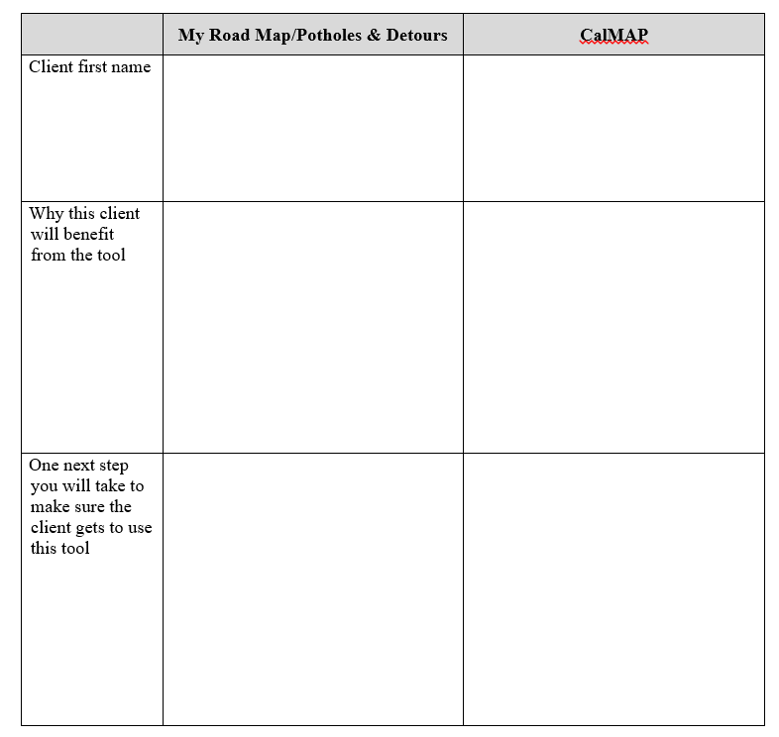
Leave: CalWORKs 2.0
Handout 5: Plan to Use Tools with Clients (p. 42)

Slide 48
Breakout by county

Slide 49
Closing

Slide 50
Questions??
Lindsay Cattell
  LCattell@mathematica-mpr.com
Notes:
End this workshop on a personal and celebratory note. For example, you can go around the room and invite everyone to share one goal that have for their coming year (either work-related or not). Others simply listen to the goal, and (silently) offer their words of support.

