Slide 1
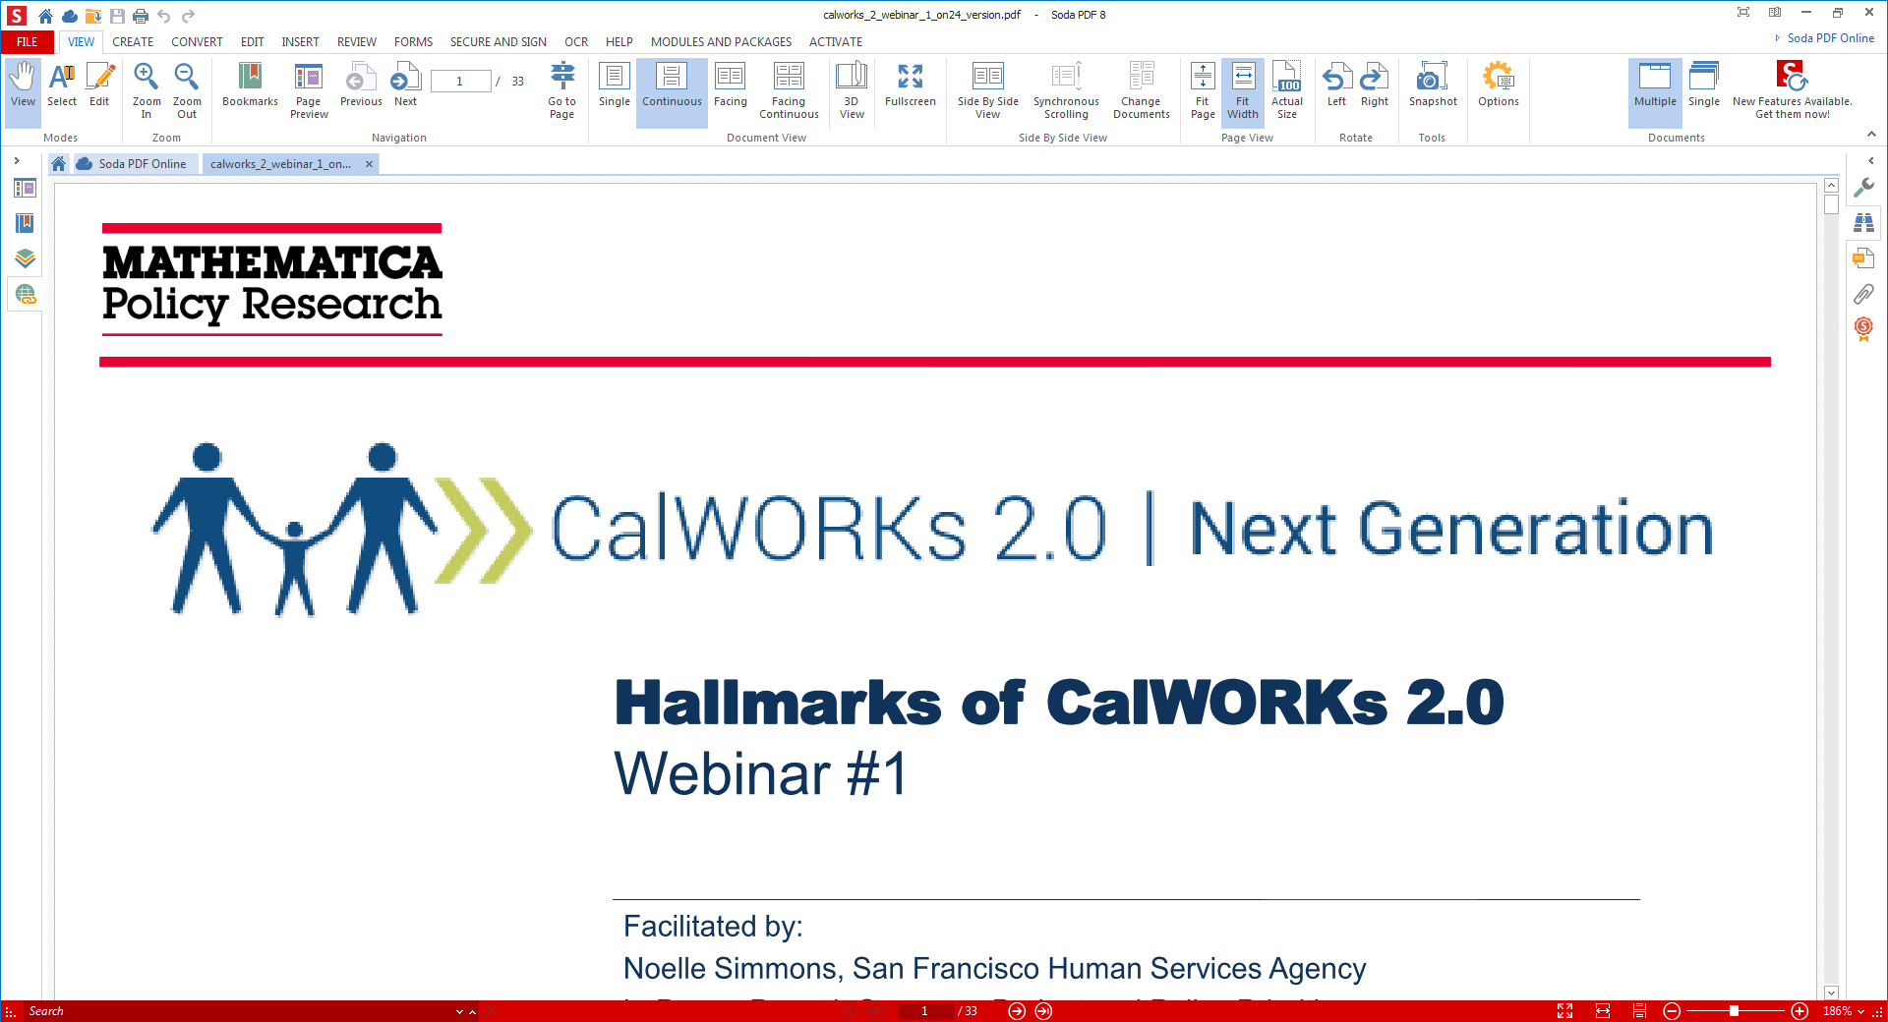

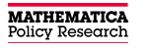
Placer County Road Test and Roll Out
In partnership with

Slide 2
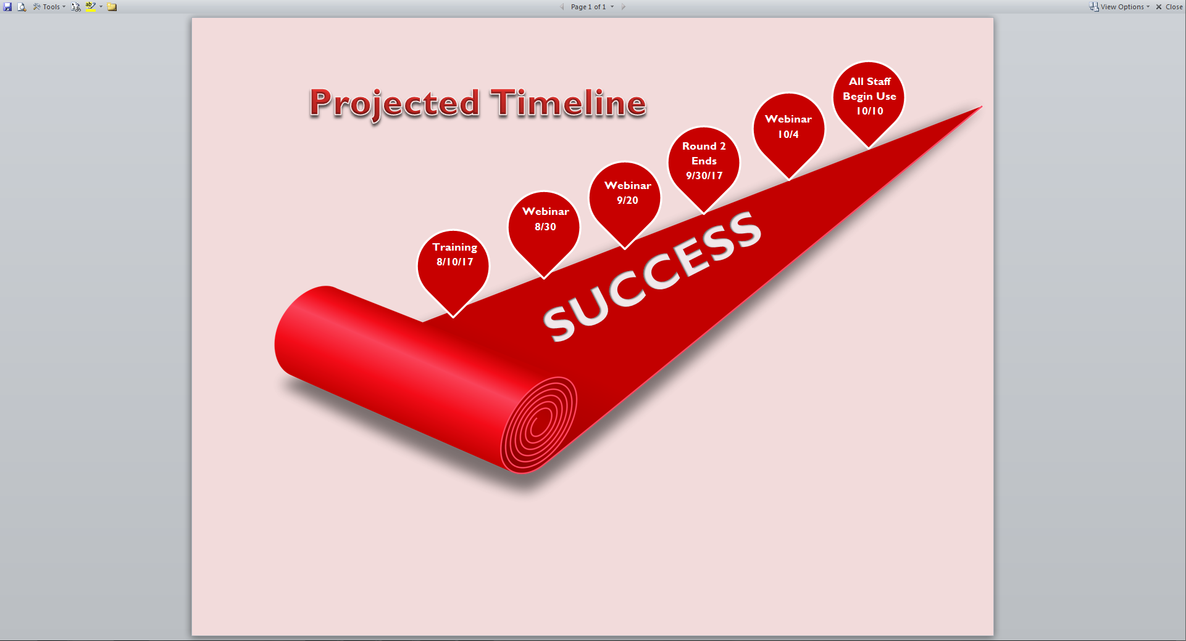

Slide 3
Cycle 1 April-May 2017
General Takeaways
Staff and customers felt positively about the tools
Tools made it easier to engage customers, discuss their goals, and have meaningful yet structured conversations
Staff reported the visual aspect of the tools was particularly helpful for goal-setting
Tools generally did not change the services provided
Staff experienced some challenges with using the tools
Time was the largest barrier to using the tools
Staff had difficulty using the tools in specific situations
Staff suggested improvements and supports for future use

Slide 4
CalWORKs 2.0 The Why, The When, & The How

Slide 5
The Why

Slide 6
CalWORKs 2.0 is the next generation vision to set families on a path to self-sufficiency by better integrating legislative initiatives into service delivery.
The Strategic Initiative has been a concentrated effort state-wide to support this shift to a whole-family tailored service approach.
The hope is to inform, inspire, and support counties in their work to strike a balance between addressing families’ diverse needs and meeting federal work participation requirements.

Slide 7
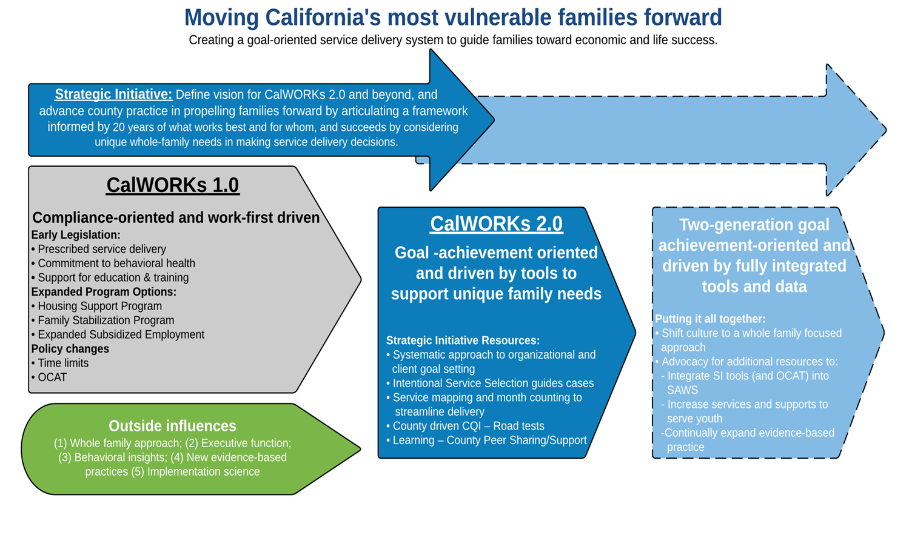

Slide 8
The When

Slide 9
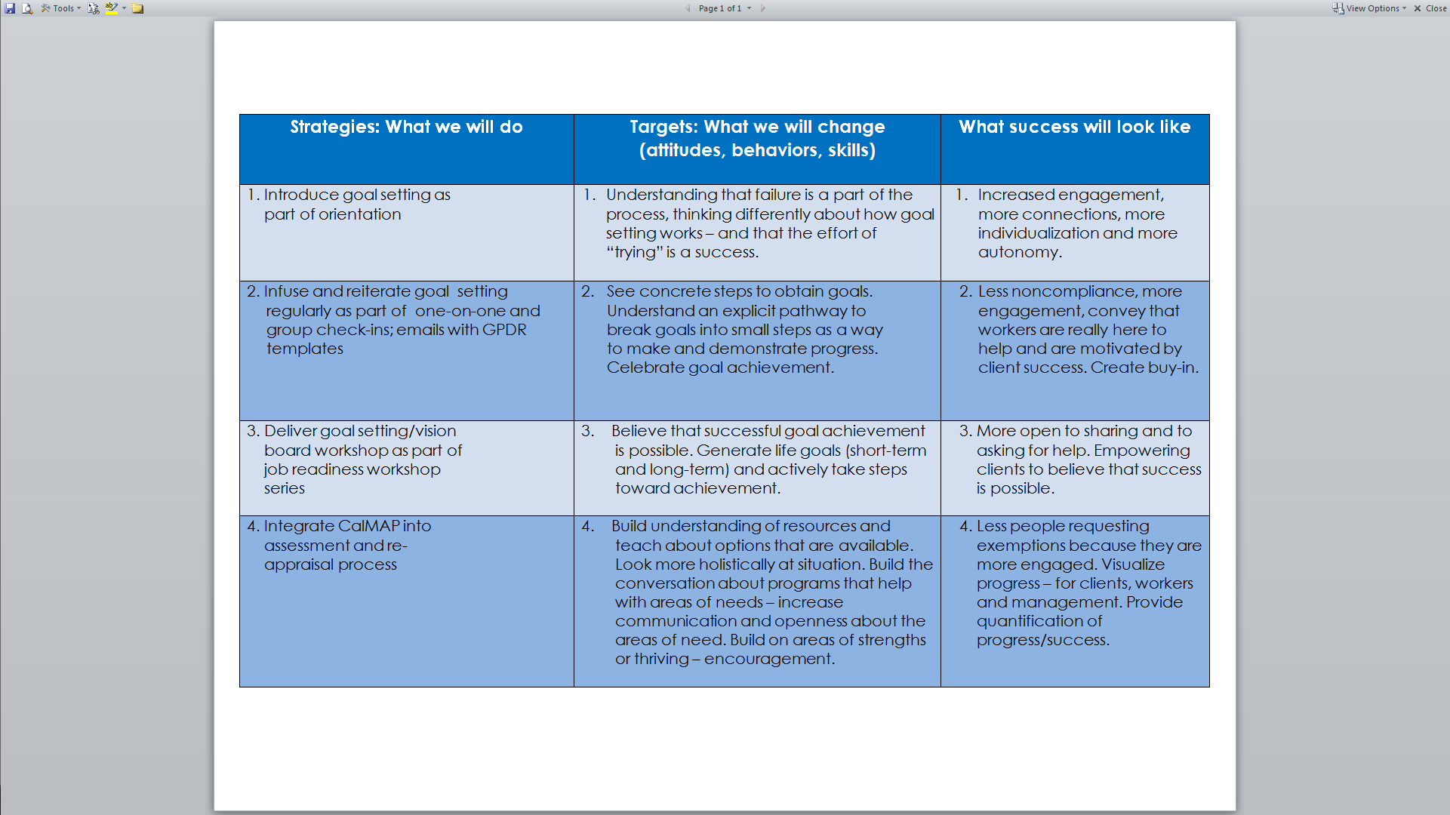

Slide 10
The How

Slide 11
Scripts
G,P,D,R Guide
CalMAP Guide
My Road Map/Potholes & Detours Guide
RAP Session Guide

Slide 12

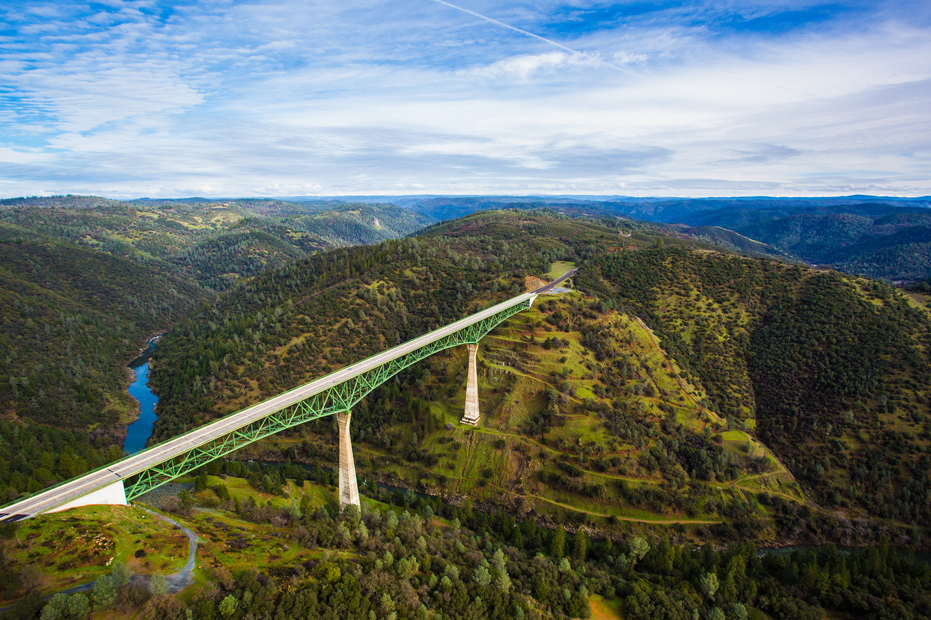
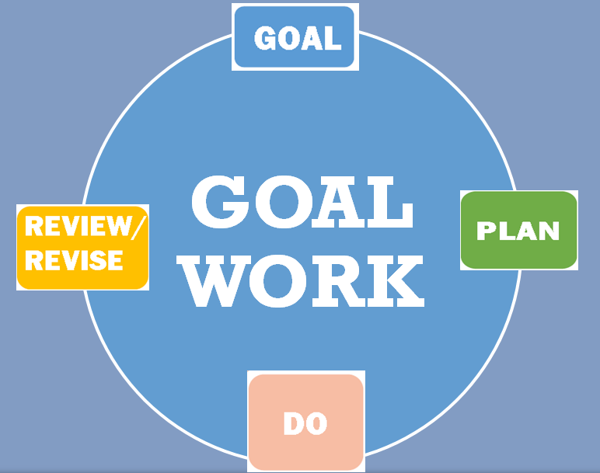
TRANSFORM CalWORKs TO GOAL WORKs!
Notes:
This is the slide from our Orientation ppt presentation.

Slide 13
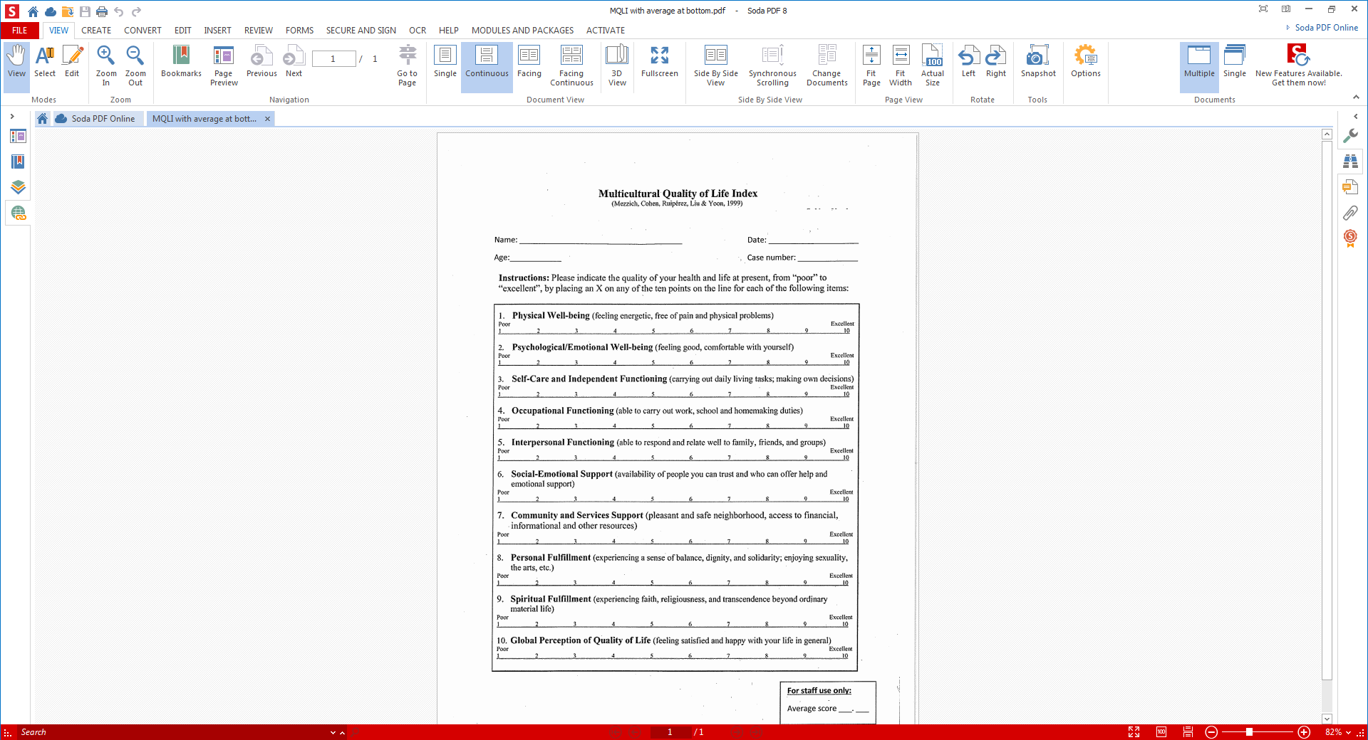

Slide 14
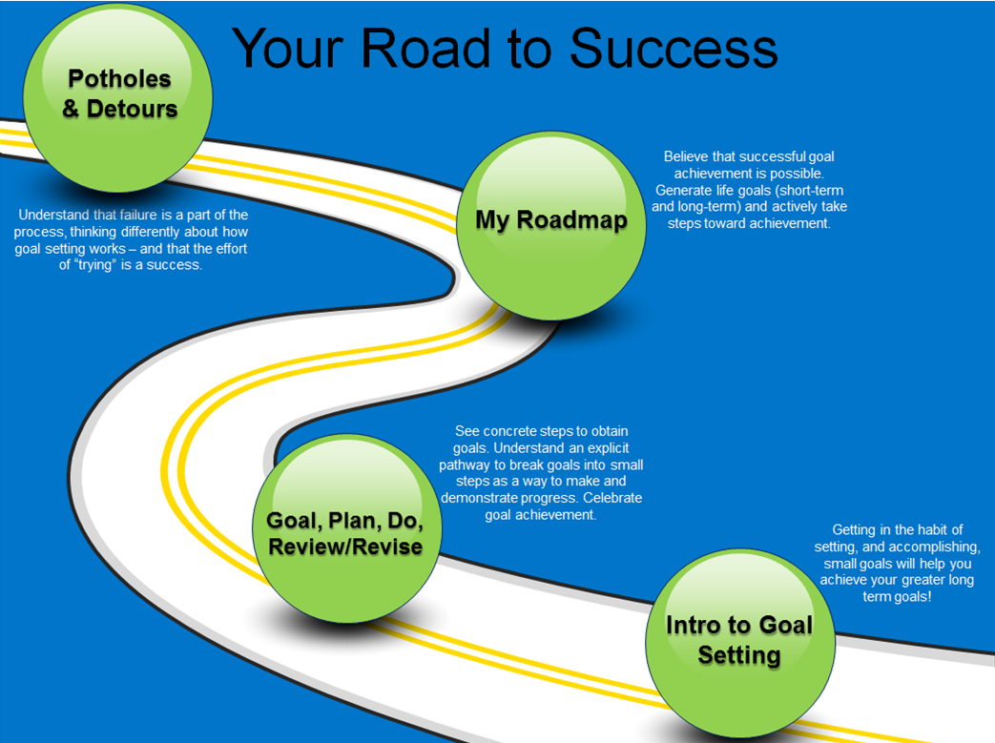

Slide 15
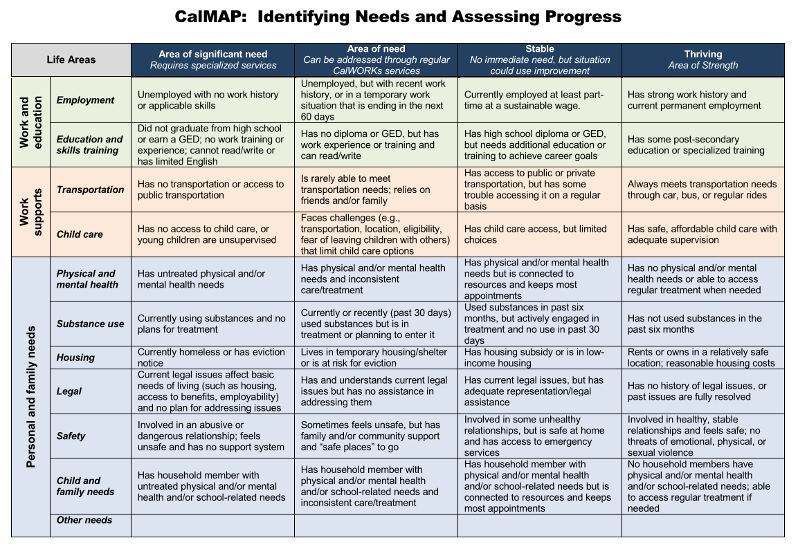
Notes:
CalMAP

Slide 16
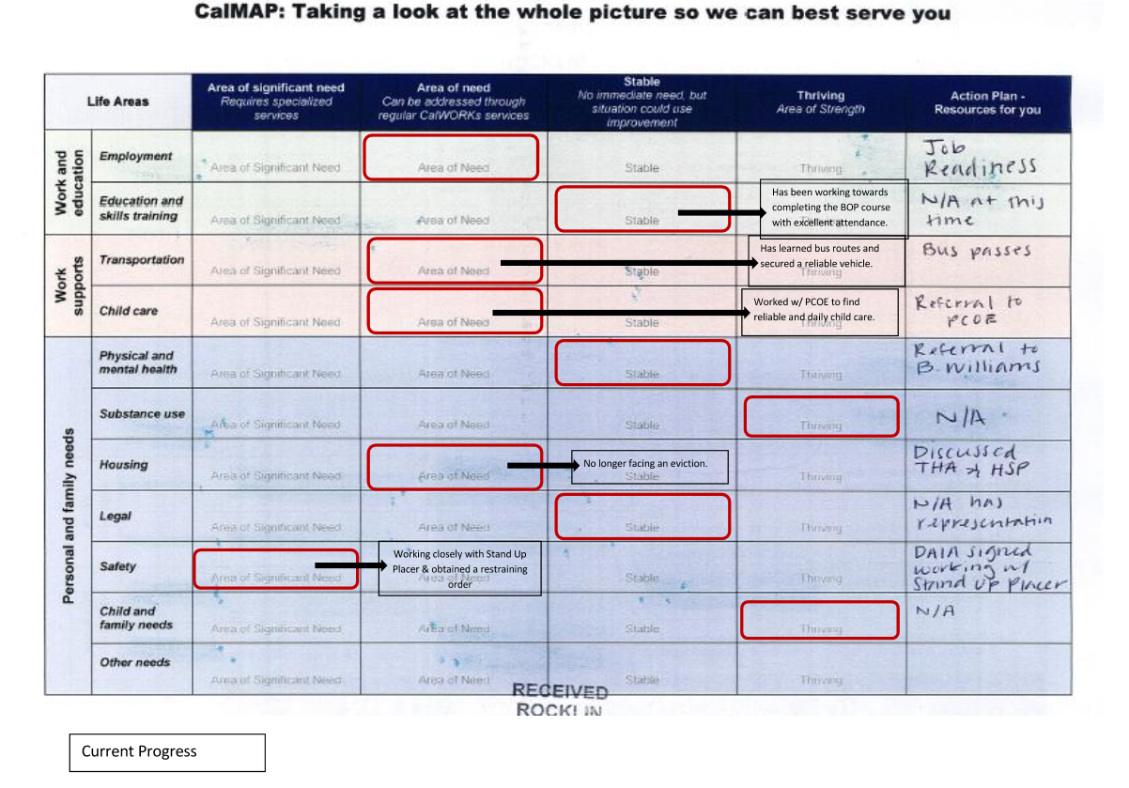
Notes:
Completed CalMAP. This is Alexis’s client.

Slide 17
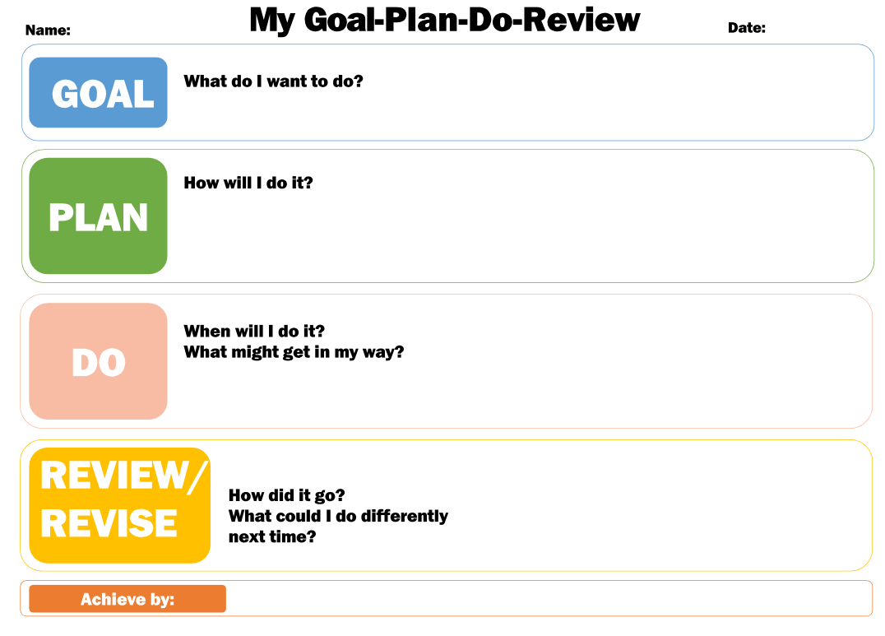
Notes:
GDPR

Slide 18
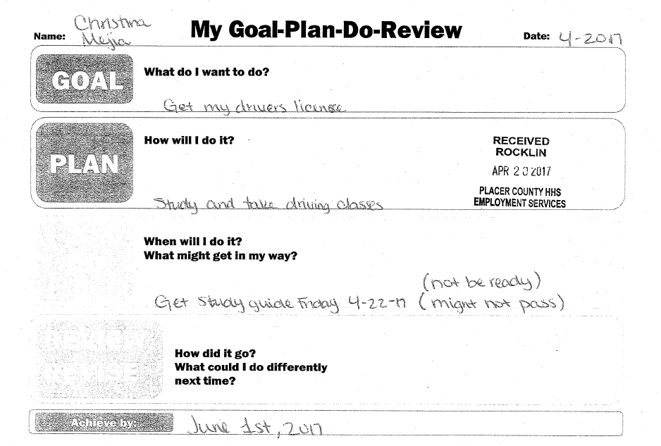
Notes:
Completed G, D, P, R. This is Jamie P.’s client.

Slide 19
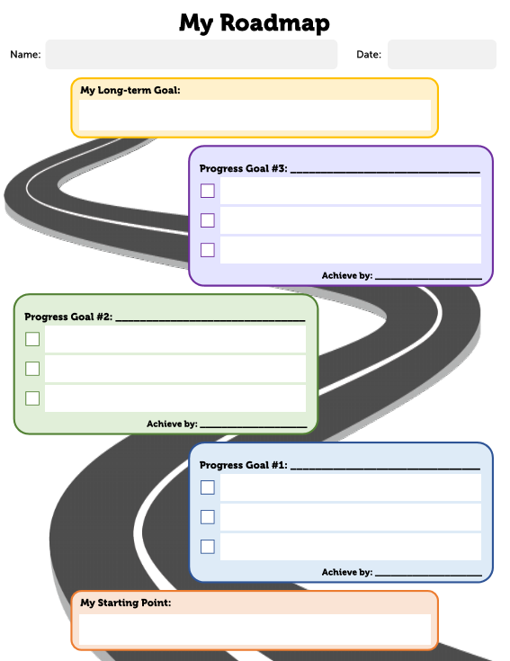
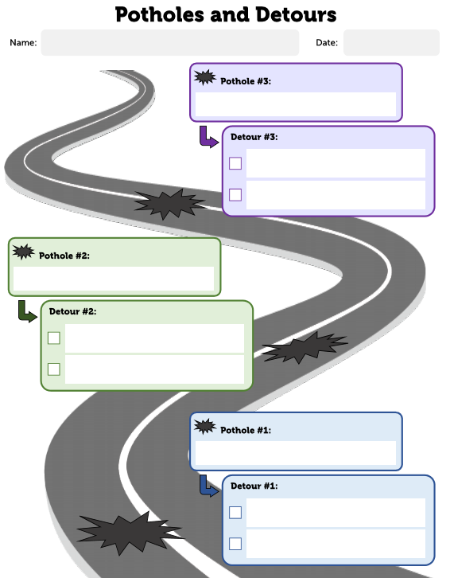
Notes:
Roadmap, Potholes/Detours- This is Jennifer’s client.

Slide 20
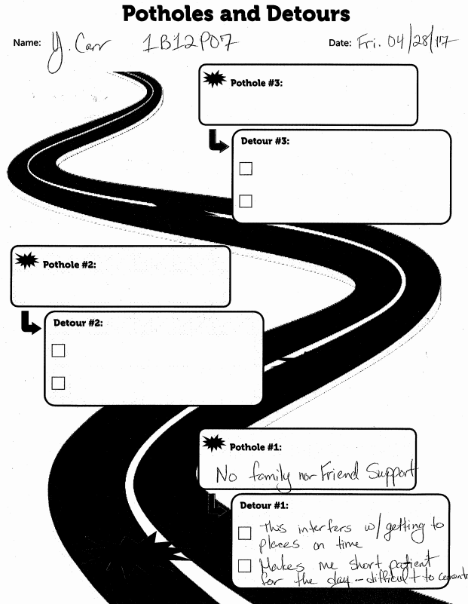
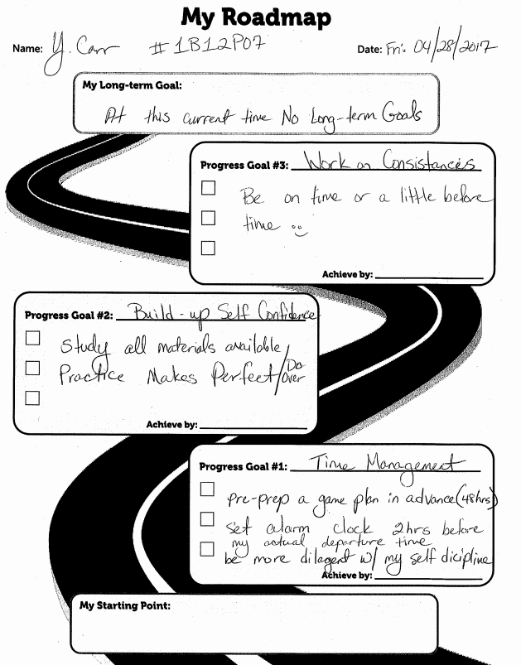

Slide 21
Helps with visualizing and thinking about the goals for your life
----------------------------------------------------------------------------------------------------------------------
Motivates you to work harder
----------------------------------------------------------------------------------------------------------------------
Encourages you to think outside the box and it assists you in opening up to new possibilities
----------------------------------------------------------------------------------------------------------------------
Serves as a reminder about what you will achieve when you get there
----------------------------------------------------------------------------------------------------------------------
Keeps you focused on your goals
----------------------------------------------------------------------------------------------------------------------
A Vision Board:
Notes:
A slide from out Vision Board/Goal Setting Workshop– Jamie P. and Jennifer conduct this workshop.

Slide 22
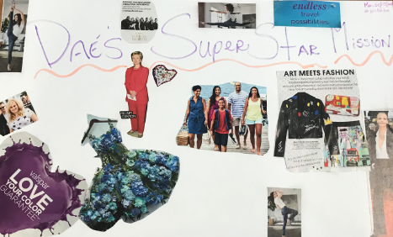
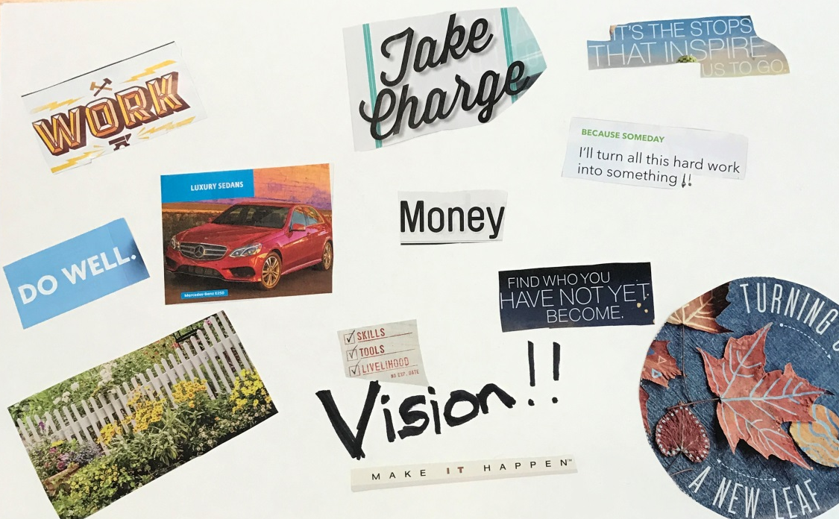
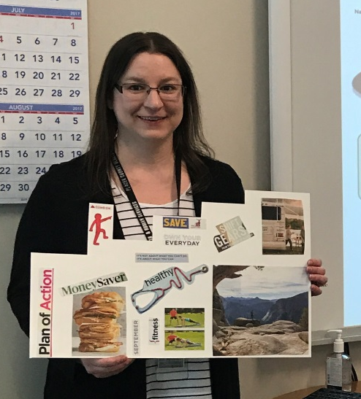
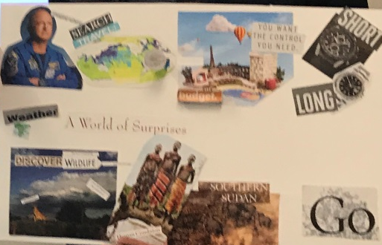
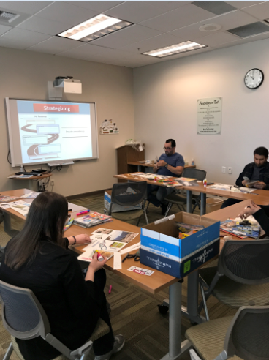
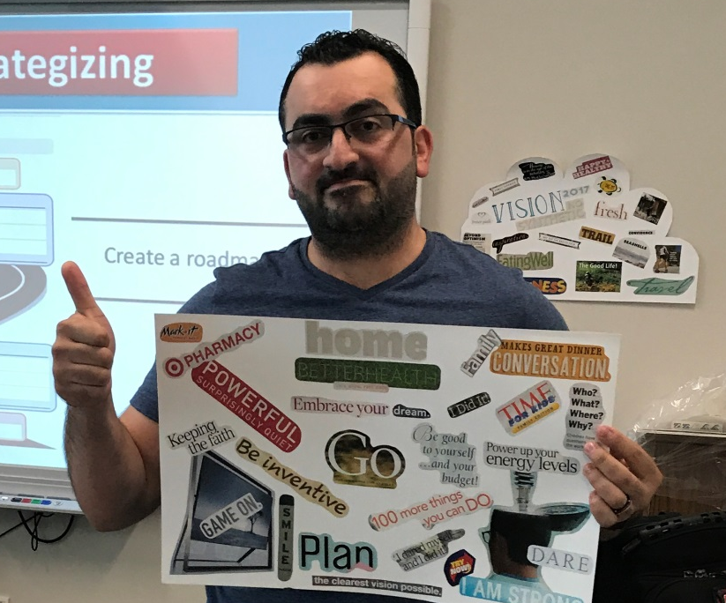
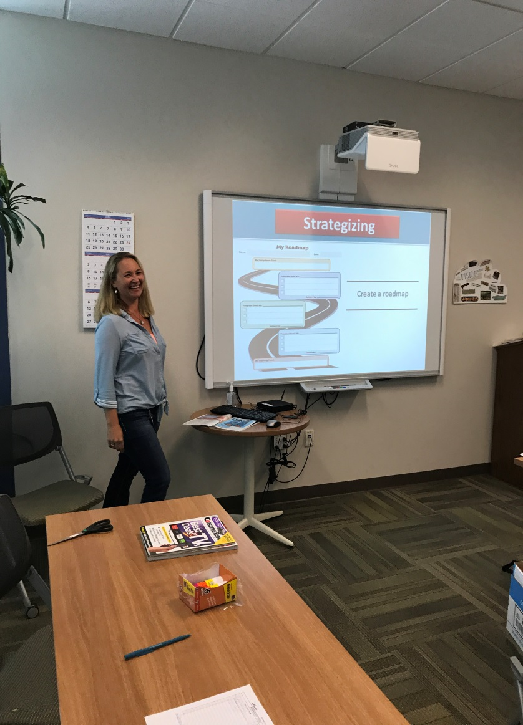
Notes:
Photos from the Vision Board workshop! Even staff got in on the fun. Jennifer completed a Vision Board of her own!!

Slide 23
Cycle 2 June-July 2017
Updated Tools
Continue with staff and customer feedback
adding feedback forms to desktop
Webinar Wednesdays @ 2pm
Aug 9- Goal Achievement- A Deeper Dive
Aug 30- Behavioral Science Behind the Initiative
Sept 20- Using SAWS Data to Manage Programs
Oct 4- Engagement Strategies to Help Families Stay in Compliance
On-line resources: CalWORKS 2.0 website

Slide 24
Next Steps
Webinar Wednesdays
Staff Implementation
Business as usual
Docs to be scanned to OnBASE: Appraisal

Slide 25
GAME TIME!

