Slide 1

PROS | CONS
INCREASED ENGAGEMENT CELEBRATE SMALL AND BIG MILESTONES CLIENT VALIDATION MOTIVATIONAL INTERVIEWING VISUAL OF PROGRESS BUILD CONFIDENCE VERSTATILITY TEACHES CLIENT GOAL SETTING AND ACHIEVEMENT OPPORTUNITY TO LEARN MORE ABOUT CLIENT STRENGTHS PROMOTES SELF REFLECTION | ADDITIONAL TIME DOUBLE ENTRIES/DOUBLE WORK CHANGE
Notes:
CW 2.0 Tools go hand in hand with Motivational Interviewing techniques.

Slide 2

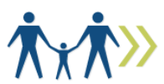
MESSAGING
“ES is here to help you set and achieve your goals!”
FAMILY FOCUSED
ONE SIZE DOES NOT FIT ALL

Slide 3




Employment
Ed/Training
SELF SUFFICENCY
Transportation
Child Care
Wellness
Housing

Slide 4

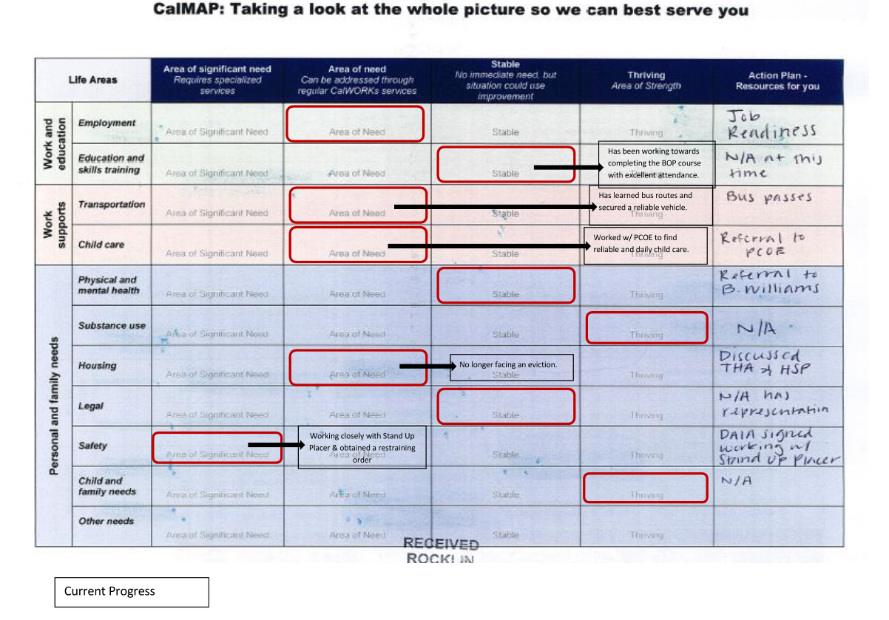

Notes:
Clts in rehab more open to utilizing the CalMAP as this often times similar to the structure of rehab.
FS- CalMAP seems to be useful
LD Clts seem to struggle with this tool as it can be overwhelming

Slide 5


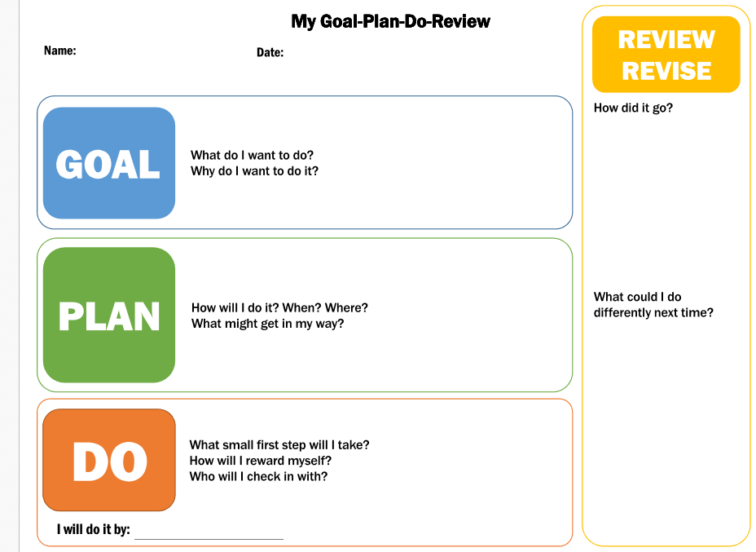
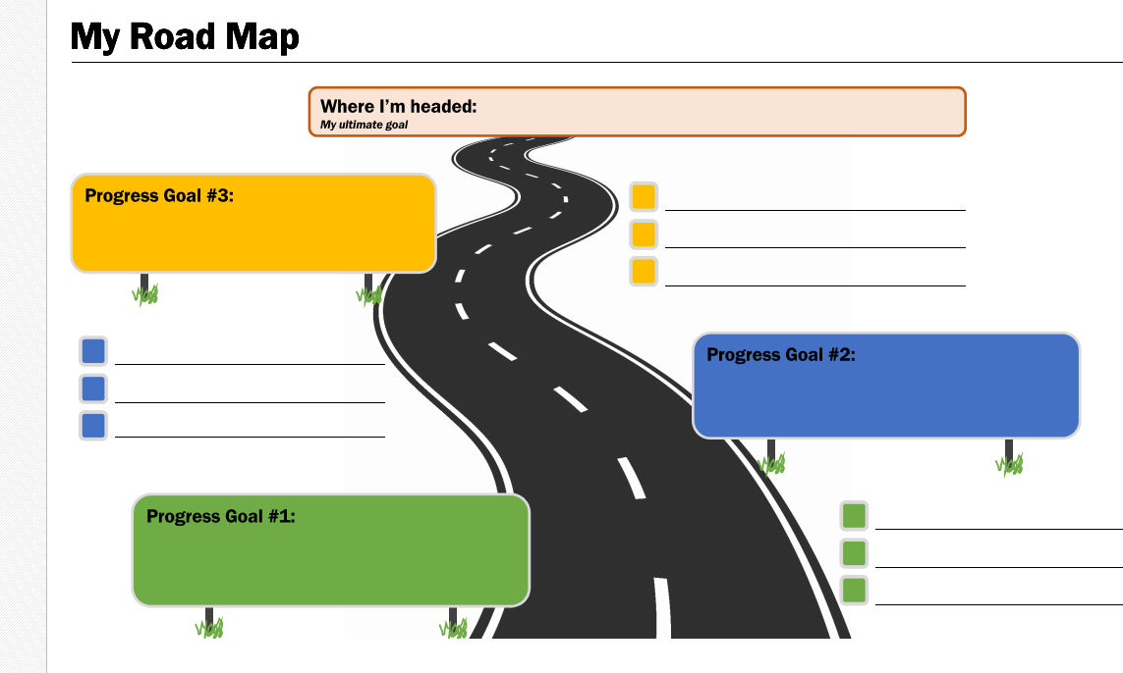
Start Small
GO BIG!

Slide 6

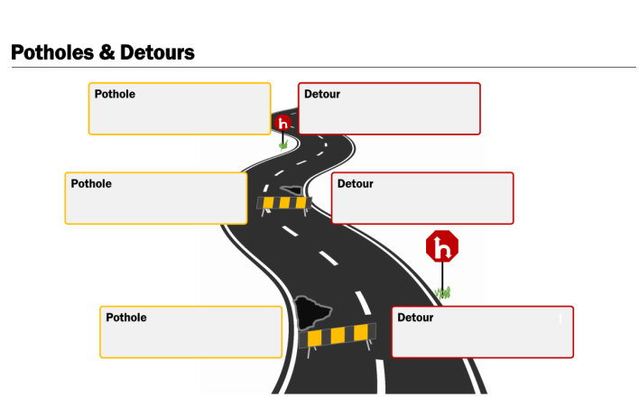
ADDRESS STUMBLES

Slide 7




Slide 8


CRISIS
TIME SPENT INTERACTING WITH THE CLIENT
ACCOUNTABILITY

Slide 9

How long does a Sanction take?

Slide 10

LET’S MEET SUSIE

Slide 11
INITIAL APPOINTMENT
You and Susie have just completed her OCAT and you are discussing next steps regarding her participation.
Notes:
“Speed Goal Works” Game. Staff to break out into pairs. One person is designate as “Susie”, one person is designated as the counselor. Pairs are given 5 min to converse utilizing each scenario.

Slide 12

Which tools, if any, did you utilize during your discussion?
Notes:
At the end of 5 min take a poll--- Show of hand how many utilized the Cal MAP during your discussion? The G. P. D, R? My Roadmap? Potholes and Detours?

Slide 13
PHONE CALL CHECK IN- 3 DAYS POST INITIAL APPT.
Susie has completed 2 weeks of Job Readiness. Susie reports that she has begun seeing a counselor and plans to continue meeting with her 1x a week. Her son continues to struggle at child care and she is worried about getting a job and being called away to attend to her son.
Susie reports successfully utilizing the G,P,D,R until she was unable to successfully complete a goal timely. Since then she reports she has become discouraged.

Slide 14
Which tools, if any, did you utilize during your discussion?
Notes:
At the end of 5 min take a poll--- Show of hand how many utilized the Cal MAP during your discussion? The G. P. D, R? My Roadmap? Potholes and Detours?

Slide 15
2ND APPOINTMENT- 1 MONTH FOLLOWING INITIAL APPT.
Susie has completed 2 weeks of job searching which included the Vision Board Workshop. She reports this was a very positive experience. She indicates she included photos of a home with a big front yard , a swing set and a dog. Susie also reported including photos of a graduation cap and gown and talks about wanting her children to go to college

Slide 16
Which tools, if any, did you utilize during your discussion?
Notes:
At the end of 5 min take a poll--- Show of hand how many utilized the Cal MAP during your discussion? The G. P. D, R? My Roadmap? Potholes and Detours?

Slide 17
3rd APPOINTMENT- 6 MONTHS FOLLOWING INITIAL APPT.
Susie reports new employment with GAP Call Center.
Susie reports that she found a child care provider skilled in dealing with her sons behavioral concerns and he has not had any issues for several weeks. Susie also reports that she continues to see her therapist however, she is now only seeing her 1x per month. Susie reports feeling positive about her families future!

Slide 18
Which tools, if any, did you utilize during your discussion?
Notes:
At the end of 5 min take a poll--- Show of hand how many utilized the Cal MAP during your discussion? The G. P. D, R? My Roadmap? Potholes and Detours?

Slide 19
Struggles?
Suggestions?
Worries?
What worked?
What didn’t?
“The secret to change is to focus all of your energy, not on fighting the old, but on building the new.”- Socrates

Slide 20
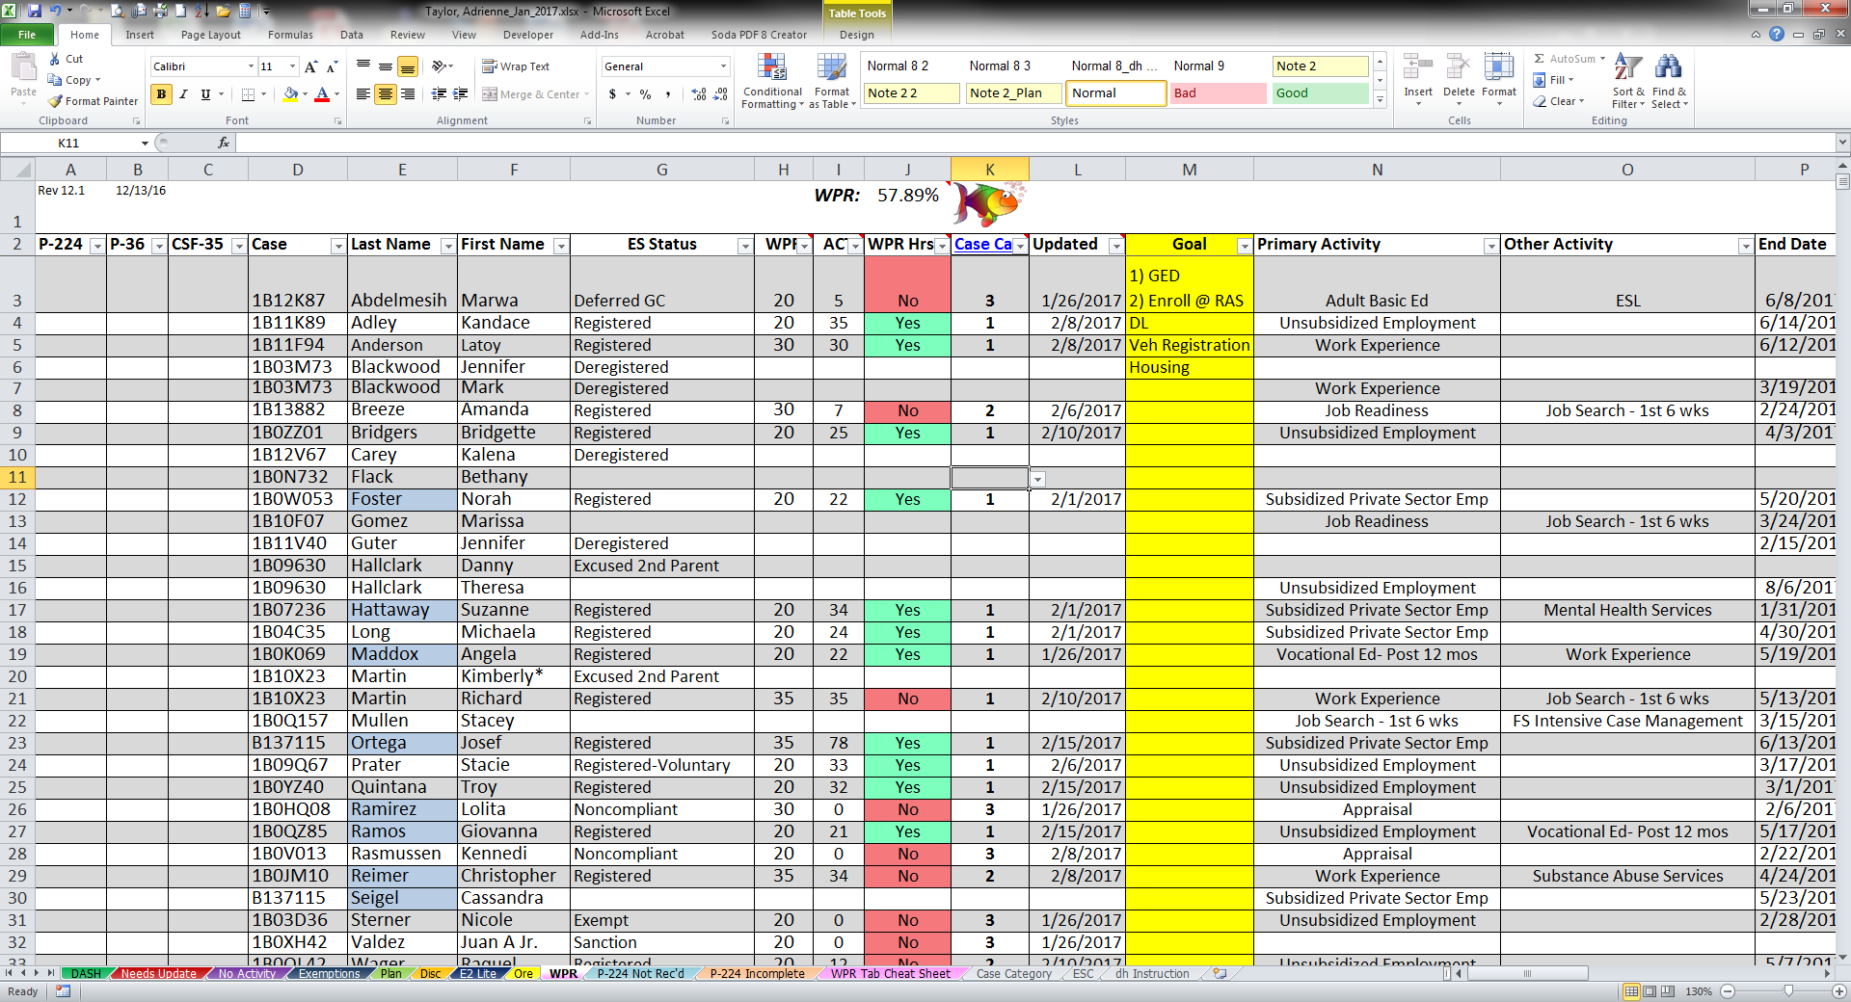
What’s Next
Target date- Tues, November 2nd, 2017
Include CalMAP, MQL in the CW Renewal Packets
Include personalized G, P, D, R with P-224s
Modify the CalMAP to include a “fill in the blank”
Display CW 2.0 tools in interview rooms for easy access!
Add to Counselor Report
“The secret to change is to focus all of your energy, not on fighting the old, but on building the new.”- Socrates

